Slide 1
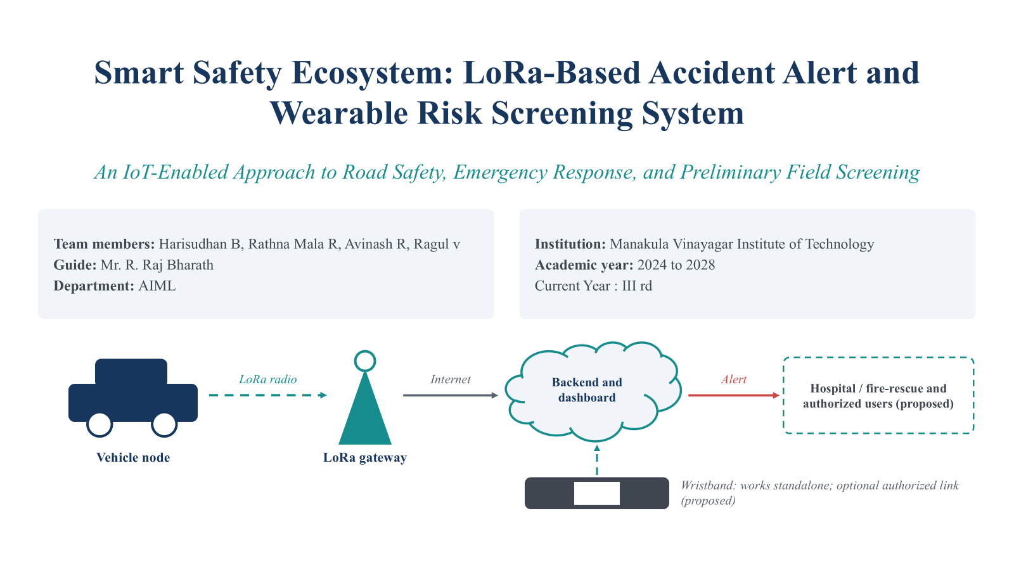
Smart Safety Ecosystem: LoRa-Based Accident Alert and Portable Wearable Risk Screening System
An IoT-Enabled Approach to Road Safety, Emergency Response, and Preliminary Field Screening
Team members: [Name 1], [Name 2], [Name 3], [Name 4]
Guide: [Guide name and designation]
Department: [Department]
Institution: [Institution name]
Academic year: [20XX to 20XX]
Review: [Project review / exhibition / symposium]
Backend and dashboard
Hospital / fire-rescue and authorized users (proposed)
LoRa radio
Internet
Alert
Vehicle node
LoRa gateway
Wristband: works standalone; optional authorized link (proposed)
Notes:
Good morning everyone. Our project is the Smart Safety Ecosystem. It brings together two safety functions: a LoRa-based accident alert module for vehicles, where LoRa stands for Long Range radio, and a portable wristband for preliminary alcohol-exposure and temperature screening. The two subsystems work independently, and an optional shared platform can show their events side by side. IoT, the Internet of Things, simply means these small devices can send data to software that others can use. Today I will explain what exists in our source designs, what we propose to add, and what still has to be validated.
Transition: Let me first show how the next few minutes are organised.

Slide 2
Agenda
1
Introduction
7
Working methodology
2
Problem statement
8
Algorithm and alert logic
3
Proposed solution
9
Real-world applications
4
Objectives
10
Benefits, limitations, and validation
5
System architecture
11
Future scope
6
Hardware and software
12
Conclusion
This talk answers:
WHAT
WHY
WHERE
WHEN
HOW
Smart Safety Ecosystem: LoRa-Based Accident Alert and Portable Wearable Risk Screening
2
Notes:
This is the roadmap. We begin with the introduction and the problem, then the proposed solution and objectives. After that comes the architecture, the hardware and software, and the working methodology, including the accident-detection flow and the wristband algorithm. We close with applications, benefits, limitations and validation, future scope and the conclusion. Along the way the talk answers five questions: what the system is, why it matters, where it can be used, when each part activates, and how it works.
Transition: We start with the problem that motivates the project.

Slide 3
Problem statement
A
Delayed accident response
B
Limited portable preliminary screening
C
Disconnected safety information
Accident details and precise location may reach responders late where conventional reporting is slow or communication is unreliable.
Laboratory screening involves sample handling, specialist equipment, transport and time. Portable tools may support preliminary field assessment, but the method depends on the substance and sample.
Accident alerts and wearable screening usually work separately. A shared platform could show different safety events to authorized staff in one consistent interface.
Honest scope: the wristband screens for alcohol exposure and monitors temperature. It does not detect NDPS (Narcotic Drugs and Psychotropic Substances). Those need a separately validated method, suitable samples and confirmatory testing.
There is a need for a portable, modular, cost-conscious system that supports rapid accident alerts and preliminary wearable screening, while keeping the two detection methods separate.
Smart Safety Ecosystem: LoRa-Based Accident Alert and Portable Wearable Risk Screening
3
Notes:
Three problems motivate this work. First, accident information and precise location may reach responders late, especially where conventional reporting is slow or communication is unreliable. Second, laboratory-based substance screening involves sample handling, specialist equipment, transport and time. Portable tools may support preliminary field assessment, but the right method depends on the substance and the sample. Third, accident alerts and wearable screening normally work separately, so authorized staff see them in different places. I want to be clear about one point from the reference problem statement on NDPS, the Narcotic Drugs and Psychotropic Substances Act. Our wristband screens for alcohol exposure and monitors temperature. It does not identify narcotic or psychotropic substances. That would need a separately validated sensing method, suitable samples and confirmatory testing where the law requires it.
Transition: With the problem defined, here is how our unified solution responds to it.

Slide 4
Proposed unified solution
A
Vehicle accident detection and LoRa emergency alert
C
Shared monitoring, logging, and notification platform
B
Wearable alcohol-exposure and temperature screening
In source design
Accelerometer and gyroscope detection
GPS location and timestamp
LoRa (Long Range) radio link to a gateway
Confirmation and manual cancellation
Optional GSM fallback
To develop for integration
Nearest-facility lookup service
Notification interfaces
Field calibration of thresholds
In source design
Nothing implemented yet; this block is proposed
To develop for integration
Event database and dashboard
Separate incident categories
Device IDs, timestamps, event logs
Access control, secure communication
Rule-based notifications
In source design
Arduino Nano with MQ-3 and MLX90614
OLED, LEDs and buzzer
Moving-average filtering
AWTRA rule-based risk score
Runs locally on the device
To develop for integration
Optional authorized data link
Sensor calibration and validation
Consent and privacy controls
Design principle: two independent detection methods, one optional shared platform. The wristband never depends on the vehicle module.
Smart Safety Ecosystem: LoRa-Based Accident Alert and Portable Wearable Risk Screening
4
Notes:
The solution has three elements. On the left is the vehicle subsystem, which detects a possible collision or rollover and sends a compact alert over LoRa. On the right is the wearable subsystem, which screens for alcohol exposure and measures non-contact temperature, and classifies the result locally on the wristband. In the middle is a shared monitoring platform that logs events and notifies authorized people. For each block I have separated what already exists in the source designs from what must still be developed for integration. The platform and the optional wristband link are proposals, not finished work. The key design principle is that the two detection methods stay separate, and an alcohol reading never implies that a driver caused an accident.
Transition: Next, the specific objectives and the boundaries of our scope.

Slide 5
Objectives and scope
1
Detect potential vehicle collisions and rollovers
In scope
Collision and rollover alerting with GPS
Alcohol-exposure screening and temperature monitoring
Shared event view (proposed)
2
Report location through a LoRa gateway architecture
3
Provide portable preliminary wearable screening
4
Apply lightweight on-device risk classification
Not claimed
Identifying specific narcotics or metabolites
Diagnosing intoxication or fever
Proving who caused an accident
Reaching a hospital without gateway and backend
5
Present separate event categories in one interface
6
Reduce avoidable false alerts with validation logic
7
Protect sensitive data and state technical limitations
Smart Safety Ecosystem: LoRa-Based Accident Alert and Portable Wearable Risk Screening
5
Notes:
These are the seven objectives. They cover collision and rollover detection, reporting location through a gateway-based architecture, portable preliminary screening, lightweight local classification, a common interface with separate event categories, fewer false alerts through confirmation and cancellation logic, and protection of sensitive data. The scope card on the right is equally important. We do not claim to identify specific narcotics, diagnose intoxication or fever, prove the cause of an accident, or reach a hospital without gateway and routing infrastructure.
Transition: Now let us look at what the system is made of, starting with the components.

Slide 6
WHAT: Components and technologies
VEHICLE SUBSYSTEM
WEARABLE SUBSYSTEM
Accelerometer and gyroscope (IMU)
GPS receiver
Arduino Nano
MQ-3 alcohol sensor
Microcontroller
LoRa transceiver
MLX90614 temperature sensor
SSD1306 OLED display
GSM module (fallback)
LoRa gateway
Buzzer
Red, yellow, green LEDs
Backend server
Facility lookup and alerts
Battery supply
Optional authorized data link
SHARED PLATFORM (all proposed)
Monitoring dashboard
Event database
Access controls
Notification interfaces
Existing: specified in source documents
Optional
Proposed
Future scope
Smart Safety Ecosystem: LoRa-Based Accident Alert and Portable Wearable Risk Screening
6
Notes:
This slide answers WHAT. The vehicle subsystem uses an accelerometer and gyroscope, a GPS receiver, a microcontroller and a LoRa transceiver, with an optional GSM module as a fallback. A LoRa gateway and a backend server receive the packet. Facility lookup and notifications are proposed additions. The wearable uses an Arduino Nano, an MQ-3 alcohol sensor, an MLX90614 non-contact infrared temperature sensor, an SSD1306 OLED display, a buzzer, red, yellow and green LEDs, and a battery. The shared platform is entirely proposed. The legend shows how to read the status of each block: solid means specified in our source documents, dashed amber means optional, dashed teal means proposed, and dotted grey means future scope.
Transition: Why do these components matter? That brings us to the motivation and benefits.

Slide 7
WHY: Motivation and benefits
1
Earlier notification
Anticipated (design intent)
Automatic alert reduces reliance on manual reporting
Faster alert delivery
Fewer unreported incidents
Quicker field triage
2
GPS-based reporting
Coordinates and timestamp travel with every alert
3
Portable preliminary screening
Quick on-site indication from a wearable
Measured in testing
Local processing
None reported in the source documents. Response time, detection accuracy and screening performance are marked To be tested.
4
Wristband classifies without cloud connectivity
5
Modular integration
Each subsystem works alone; platform is optional
Alcohol screening is not confirmed intoxication.
Smart Safety Ecosystem: LoRa-Based Accident Alert and Portable Wearable Risk Screening
7
Notes:
This slide answers WHY. Earlier notification matters because an automatic alert reduces dependence on someone manually reporting the crash. GPS coordinates and a timestamp travel with every alert, so responders know where to look. The wristband gives a quick, portable, preliminary indication on site, and because classification runs on the microcontroller it works without cloud connectivity. Modularity means each subsystem works alone and the shared platform is optional. I must stress that these are anticipated benefits from the design. No measured response-time improvement or detection accuracy is reported in our source documents, so we show those fields as to be tested. Also, an alcohol screening reading is not equivalent to confirmed intoxication.
Transition: Next, where the system can be used and when each part activates.

Slide 8
WHERE and WHEN: Deployment and activation
WHERE (all proposed)
WHEN
Roadways and highways
Campuses
Vehicle subsystem
Monitor motion
Threshold exceeded
Confirm and cancel window
GPS fix and LoRa send
Needs gateway coverage along the route
Gateway on site; campus vehicles
Fleet operations
Industrial workplaces
Wearable subsystem
Fleet-wide alert logging
Site vehicles and staff screening
Periodic measurement
Moving-average filter
AWTRA risk score
OLED, LED, buzzer
Authorized field screening
Emergency-response networks
Consent and authority required
Needs agreed integration
Deployment limits: LoRa needs gateway coverage and internet backhaul at the gateway. Wearable screening needs a suitable sensing environment (sensor warm-up, calibration, limited gas interference).
Smart Safety Ecosystem: LoRa-Based Accident Alert and Portable Wearable Risk Screening
8
Notes:
This slide answers WHERE and WHEN. Where: roadways and highways, campuses, fleet operations, industrial workplaces, authorized field-screening environments, and emergency-response networks. All of these are proposed deployments, not tested installations. When: the vehicle subsystem monitors motion continuously. When a threshold is exceeded, it enters a confirmation window, then a manual cancellation period. If the alert is not cancelled, it acquires a GPS fix and transmits a LoRa packet. The wearable runs a periodic measurement cycle: read the sensors, filter with a moving average, compute the AWTRA risk score, and show the status on the OLED, LEDs and buzzer. Two limits apply. LoRa needs suitable gateway coverage and an internet connection at the gateway. Wearable screening needs an appropriate sensing environment, for example sensor warm-up, calibration and limited airflow or gas interference.
Transition: Now the core technical view: the system architecture.

Slide 9
Main system architecture
VEHICLE SUBSYSTEM
SHARED PLATFORM
LoRa
Internet
Accelerometer and gyroscope
Microcontroller
Confirmation and manual cancel
GPS fix and timestamp
LoRa transceiver
LoRa gateway
Backend service
RESPONSE
Nearest-facility lookup
Hospital and fire-rescue (proposed)
WEARABLE SUBSYSTEM (works standalone; no cloud needed to classify)
Authorized notifications
MQ-3 and MLX90614 sensors
Arduino Nano
Moving-average filter
AWTRA rule-based class
OLED, LEDs, buzzer
Optional authorized link
Authorized monitoring staff (proposed)
Event database and dashboard
Proposed; separate records for accident and screening events
Coverage and gateways
Plan gateway placement; allow multiple gateways; retry unacknowledged packets.
Security and privacy
Device authentication, encrypted payload, role-based access, consent for screening data.
Failure handling
No GPS: flagged packet. No LoRa: optional GSM. Backend down: queue and retry.
Sensor data
LoRa radio
Internet backhaul
Emergency notification
Dashed teal: proposed, not implemented
Smart Safety Ecosystem: LoRa-Based Accident Alert and Portable Wearable Risk Screening
9
Notes:
This is the main architecture. The top lane is the vehicle subsystem. Motion sensors feed the microcontroller, which applies the confirmation and manual cancellation logic, then reads the GPS and sends a compact packet over LoRa to the gateway. The gateway forwards it over the internet to the backend. The important point is that LoRa itself never contacts a hospital. The gateway and backend do the routing: the backend identifies nearby hospitals and fire-rescue facilities and sends notifications. The lower lane is the wearable. The MQ-3 and MLX90614 feed the Arduino Nano, which filters the readings, applies the AWTRA rules, and drives the OLED, LEDs and buzzer. This works entirely on its own. The dashed link to the platform is optional and proposed, and would carry only authorized records. The right-hand column is the shared platform with separate event records. All dashed teal blocks are proposed, not implemented. For a real deployment we would add multiple gateways for coverage, device authentication and encrypted payloads, database maintenance, retry and queueing, and a GSM fallback where available.
Transition: Let us now walk through the accident-detection workflow step by step.

Slide 10
HOW: Accident detection workflow
Read accelerometer and gyroscope data
Impact or rollover?
Confirm event with thresholds and window
Activate warning
Start
No: keep monitoring
Transmit via LoRa
Construct compact packet
Acquire GPS fix and timestamp
Cancelled?
Start manual cancellation window
No: continue
Alternate paths
Gateway forwards packet to backend
Backend identifies nearby facilities
Send hospital and fire-rescue notification
No GPS fix
Send flagged packet; use last known fix if available
No gateway coverage
Retry; optional GSM fallback where available
Cancelled in window
Return to monitoring; no alert sent
Dashed teal steps are proposed. Thresholds are preliminary calibration values from the source design, not universal crash-detection standards; calibrate for each vehicle.
Smart Safety Ecosystem: LoRa-Based Accident Alert and Portable Wearable Risk Screening
10
Notes:
Here is the accident workflow. The device starts by reading accelerometer and gyroscope data continuously. When the motion pattern suggests a possible impact or rollover, it checks the event against calibrated thresholds over a short confirmation window. If it is confirmed, the device activates a warning and starts a manual cancellation window, so a harmless bump can be cancelled. If nobody cancels, it acquires a GPS fix with a timestamp, builds a compact packet, and transmits it over LoRa. The gateway forwards the packet to the backend, which identifies nearby hospitals and fire-rescue facilities and sends notifications. That last step is a proposed deployment. The panel at the lower right shows alternate paths: if there is no GPS fix we send a flagged packet, with the last known position if available. If there is no gateway coverage, the device retries, and a GSM fallback can be used where implemented. The thresholds in the source are preliminary calibration values, not universal crash-detection standards, and must be calibrated for each vehicle.
Transition: Now the second subsystem: the wearable screening flow and the AWTRA algorithm.

Slide 11
HOW: Wearable screening and AWTRA algorithm
Read MQ-3 and MLX90614 sensors
Moving-average filtering
Temperature class and alcohol evaluation
Weighted risk score
Status classification
OLED, LED, buzzer alert
0 to 39
40 to 79
80 or above
Read with care
Safe
Medium risk
High risk
Prototype rules; need calibration and validation
Rule-based logic, not a trained model
Temperature is not a fever or intoxication diagnosis
MQ-3 may respond to other gases
Screening is not confirmed intoxication
Illustrative example (values for explanation only, not measured data)
Step | Filtered input | Weighted contribution
Alcohol-sensor evaluation | Elevated reading | 55
Temperature classification | Within expected range | 0
Risk score | Sum of contributions | 55: Medium risk
Score = weighted alcohol contribution + weighted temperature contribution; the filtered score then maps to a band.
Smart Safety Ecosystem: LoRa-Based Accident Alert and Portable Wearable Risk Screening
11
Notes:
This is the wearable pipeline. The Arduino Nano reads the MQ-3 alcohol sensor and the MLX90614 non-contact temperature sensor. A moving average smooths noisy readings. The AWTRA, the Adaptive Weighted Threshold Risk Algorithm, evaluates the filtered values: it classifies temperature, evaluates the alcohol-sensor reading, and combines them into a weighted risk score. The documented bands are 0 to 39 Safe, 40 to 79 Medium risk, and 80 or above High risk. The OLED shows the status and the LEDs and buzzer give a local alert. This is rule-based threshold logic running on a microcontroller. It is not a trained machine-learning or deep-learning model. The worked example on the slide uses illustrative numbers only, to show how contributions add up, and they are not measured data. These are prototype rules. They need sensor calibration and validation, and they are not clinically validated thresholds. Temperature from the MLX90614 is not a diagnosis of fever or intoxication, and the MQ-3 can respond to other gases besides alcohol vapour.
Transition: Next, the hardware, software and data flow in one table.

Slide 12
Hardware, software, and data flow
Component | Purpose | Subsystem | Status
Accelerometer and gyroscope (IMU) | Detects impact and rollover motion | Vehicle | Existing
GPS receiver | Latitude, longitude and timestamp (TinyGPS++) | Vehicle | Existing
Vehicle microcontroller | Thresholds, cancel window, packet building | Vehicle | Existing
LoRa transceiver | Long-range low-power uplink to gateway | Vehicle | Existing
GSM module | Fallback alert path where available | Vehicle | Optional
LoRa gateway | Receives packets; forwards over internet | Vehicle | Existing
Backend and database | Event logs, facility lookup, notification rules | Shared | Proposed
Dashboard and notifications | Separate event categories; authorized alerts | Shared | Proposed
Arduino Nano | Reads sensors; runs filtering and AWTRA | Wearable | Existing
MQ-3 alcohol sensor | Alcohol-vapour sensing for screening | Wearable | Existing
MLX90614 temperature sensor | Non-contact temperature reading | Wearable | Existing
SSD1306 OLED display | Shows reading and risk status | Wearable | Existing
Buzzer and red, yellow, green LEDs | Local alert indication | Wearable | Existing
Battery supply | Portable operation | Wearable | Existing
Software: Arduino IDE, Embedded C/C++, TinyGPS++, LoRa library, MLX90614 and SSD1306 libraries, backend and database stack (to be chosen). Existing = specified in source documents.
Smart Safety Ecosystem: LoRa-Based Accident Alert and Portable Wearable Risk Screening
12
Notes:
This table summarises every component with its purpose, its subsystem and its implementation status. Existing means the item is specified in our source documents. Optional covers the GSM fallback. Proposed covers the backend stack, the dashboard and notifications, which would be built for integration. For software we use the Arduino IDE and Embedded C and C++. TinyGPS++ parses the GPS data, and we use a LoRa library for the radio and the standard libraries for the MLX90614 and the SSD1306 display. The backend and database stack is a design choice still to be made, and I am not claiming specific component specifications or costs here. In terms of data flow, the vehicle sends a compact packet over LoRa through the gateway to the backend, while the wearable classifies locally and may send an authorized record in an extended version.
Transition: With the design explained, here is where it could be applied.

Slide 13
Real-world applications and deployment
1
Fleet and road-safety monitoring
2
Campus and industrial vehicle safety
3
Emergency-response coordination
Vehicle alerts with GPS logged by fleet operators.
On-site gateway covers campus or plant vehicles.
Alerts routed to agreed responders through the backend.
Status: plausible future deployment; no tested installation
Status: plausible future deployment; no tested installation
Status: plausible future deployment; no tested installation
4
Authorized workplace safety programs
5
Preliminary screening research
6
Connected wearable monitoring
Consent-based preliminary alcohol-exposure screening.
Platform for studying validated screening methods.
Optional secure link of screening records to the platform.
Status: plausible future deployment; no tested installation
Status: plausible future deployment; no tested installation
Status: plausible future deployment; no tested installation
Realistic limitations
Gateway coverage
Sensor calibration
Environmental interference
Power management
False positives
Privacy
Regulatory approval
Smart Safety Ecosystem: LoRa-Based Accident Alert and Portable Wearable Risk Screening
13
Notes:
These are the application areas we see. Fleet and road-safety monitoring would use the vehicle module with gateways along routes. Campus and industrial vehicle safety suits a site with one or two gateways. Emergency-response coordination depends on an agreed integration with responders. Authorized workplace safety programs and preliminary screening research could use the wristband, with consent. Connected wearable monitoring covers the optional link to the platform. For every card, the status is a plausible future deployment. None has been tested as an installation. The strip at the bottom lists realistic limitations: gateway coverage, sensor calibration, environmental interference, power management, false positives, privacy, and regulatory approval. Any use that affects people, such as screening in a workplace, needs appropriate consent, policy and approval.
Transition: That brings us to how we would test and validate the system, and its limitations.

Slide 14
Testing, validation, and limitations
Test | Method | Metric | Result
Controlled impact-sensor tests | Controlled impacts and tilt at varied severity | Detection rate, missed events | To be tested
GPS acquisition and accuracy | Open-sky and obstructed fixes vs reference | Time to fix, position error | To be tested
LoRa packet reception and loss | Range and obstruction trials | Delivery ratio, signal strength | To be tested
Gateway and backend delivery | Packet through gateway to backend log | Delivery success, latency | To be tested
Nearest-facility lookup | Compare output with known facility locations | Correct facility returned | To be tested
False-trigger and manual-cancel | Everyday motion; cancel within the window | False alerts, cancel success | To be tested
Wearable sensor repeatability | Repeated readings at known conditions | Reading spread, drift | To be tested
AWTRA classification consistency | Fixed input sets against expected bands | Band agreement | To be tested
Battery endurance | Continuous operation to cutoff | Operating hours | To be tested
Data access and communication security | Authentication, encryption, access review | Unauthorized access blocked | To be tested
Validation boundaries: emergency use needs appropriate safety validation. Substance screening needs validated methods and confirmatory testing where legally required.
Smart Safety Ecosystem: LoRa-Based Accident Alert and Portable Wearable Risk Screening
14
Notes:
This is our validation plan. The source documents do not report measured results, so every result field says To be tested, and we are deliberately not showing any invented accuracy figures. We plan to test controlled impact detection, GPS acquisition and location accuracy, LoRa packet reception and loss, gateway-to-backend delivery, nearest-facility lookup, false triggers and manual cancellation, wearable sensor repeatability, AWTRA classification consistency, battery endurance, and data access and communication security. Two cautions: emergency use requires appropriate safety validation before anyone relies on it, and any substance screening requires validated methods, with confirmatory testing where legally required. A preliminary positive result is never proof.
Transition: Finally, how the project could grow: the future scope.

Slide 15
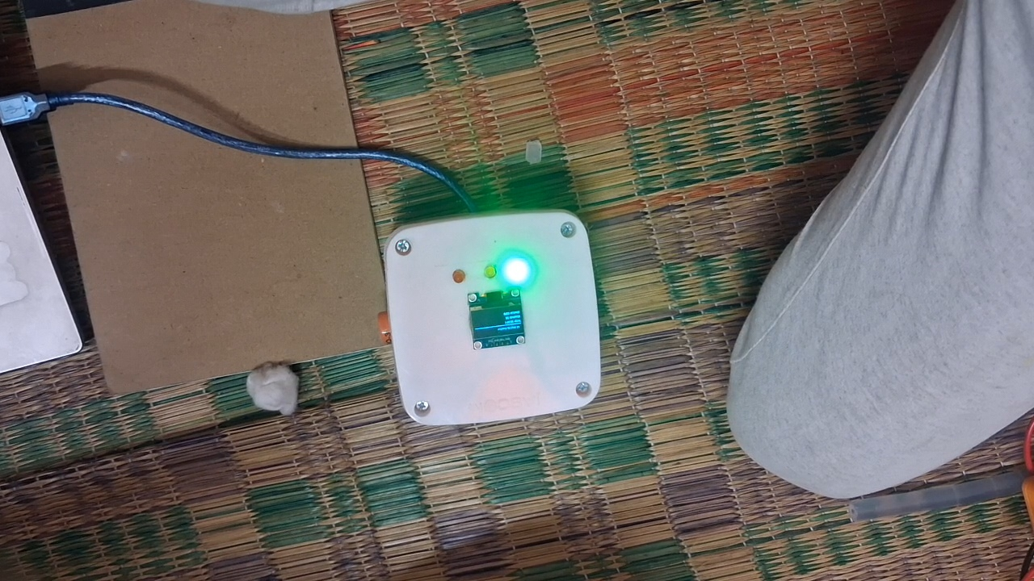
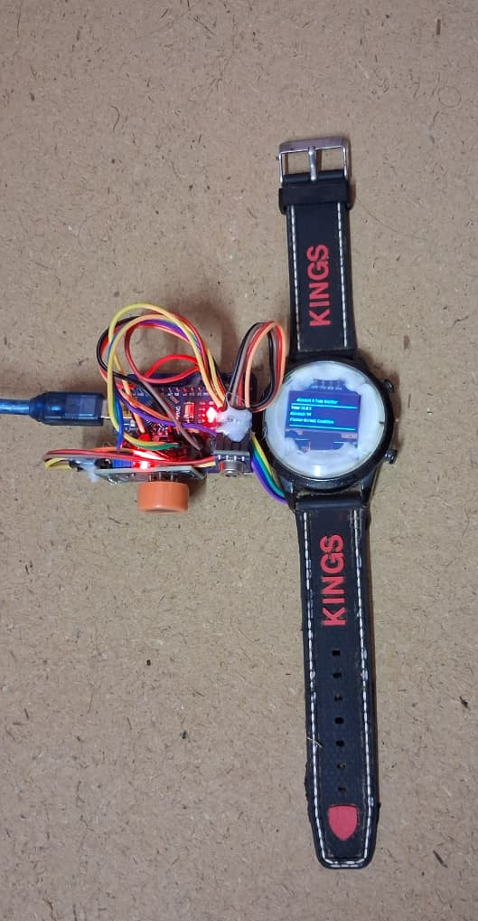
Prototype
Smart Safety Ecosystem: LoRa-Based Accident Alert and Portable Wearable Risk Screening
15
Notes:
Our future scope has eight items, grouped in an indicative order. First, planning coverage with multiple LoRa gateways, adding secure device authentication and payload protection, and validating the wearable sensors more thoroughly. Next, more reliable emergency-service integration, a mobile application and unified dashboard, and privacy-preserving event storage with access auditing. Over the longer term, we want expanded field trials and performance evaluation, and, only if independently validated, additional substance-specific screening technologies. This last point addresses the NDPS problem honestly: it needs a different validated sensing method, not a reinterpretation of the current sensors.
Transition: Let me close with the conclusion.

Slide 16
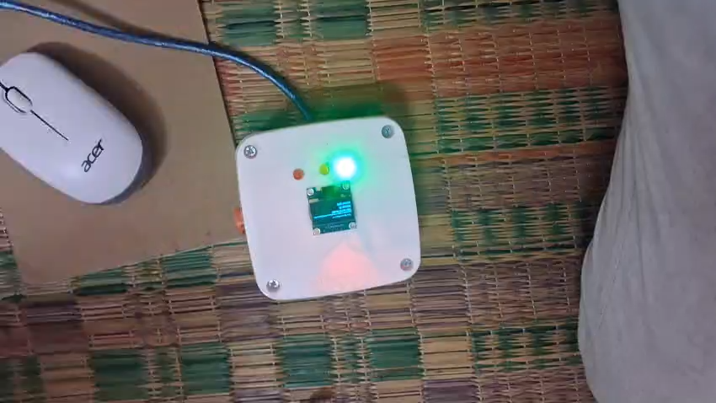
Prototype Demo Video
Smart Safety Ecosystem: LoRa-Based Accident Alert and Portable Wearable Risk Screening
15
Notes:
Our future scope has eight items, grouped in an indicative order. First, planning coverage with multiple LoRa gateways, adding secure device authentication and payload protection, and validating the wearable sensors more thoroughly. Next, more reliable emergency-service integration, a mobile application and unified dashboard, and privacy-preserving event storage with access auditing. Over the longer term, we want expanded field trials and performance evaluation, and, only if independently validated, additional substance-specific screening technologies. This last point addresses the NDPS problem honestly: it needs a different validated sensing method, not a reinterpretation of the current sensors.
Transition: Let me close with the conclusion.

Slide 17




SDG Goal
SDG 3 – Good Health and Well-Being: “Promoting health, safety, and faster emergency response.”
1
SDG 8 – Decent Work and Economic Growth: “Supporting safer workplaces through portable wearable screening.”
2
SDG 9 – Industry, Innovation and Infrastructure: “Driving innovation through smart IoT and LoRa technology.”
3
SDG 11 – Sustainable Cities and Communities: “Building safer communities through intelligent accident alerts.”
4
Smart Safety Ecosystem: LoRa-Based Accident Alert and Portable Wearable Risk Screening
16
Notes:
To conclude: the Smart Safety Ecosystem combines two complementary safety functions through a modular monitoring approach. One is location-based accident alerting. The other is portable preliminary wearable screening. The gateway and backend make emergency routing possible, because LoRa on its own does not contact a hospital. The wearable uses a separate local classification process, and an alcohol reading never proves that a driver caused an accident. Real-world deployment depends on validation, reliable communication, appropriate screening technology, security, and regulatory compliance. Thank you. I would be happy to take your questions.
Transition: Thank you. Questions, please.

Slide 18
Future scope
Near term
Mid term
Longer term
Multiple LoRa gateways and coverage planning
More reliable emergency-service integration
Expanded field trials and performance evaluation
1
4
7
Secure device authentication and payload protection
Mobile application and unified dashboard
Additional substance-specific screening, only if independently validated
2
5
8
Improved wearable sensor validation
Privacy-preserving event storage and access auditing
3
6
Smart Safety Ecosystem: LoRa-Based Accident Alert and Portable Wearable Risk Screening
15
Notes:
Our future scope has eight items, grouped in an indicative order. First, planning coverage with multiple LoRa gateways, adding secure device authentication and payload protection, and validating the wearable sensors more thoroughly. Next, more reliable emergency-service integration, a mobile application and unified dashboard, and privacy-preserving event storage with access auditing. Over the longer term, we want expanded field trials and performance evaluation, and, only if independently validated, additional substance-specific screening technologies. This last point addresses the NDPS problem honestly: it needs a different validated sensing method, not a reinterpretation of the current sensors.
Transition: Let me close with the conclusion.

Slide 19
Conclusion
Two complementary safety functions in one modular approach: location-based accident alerting and portable preliminary screening
1
Gateway and backend enable emergency routing; LoRa alone does not contact a hospital
Thank You
2
The wristband classifies locally with the rule-based AWTRA, separately from the vehicle module
Questions and discussion are welcome
3
Deployment depends on validation, reliable communication, appropriate screening technology, security, and regulatory compliance
4
Smart Safety Ecosystem: LoRa-Based Accident Alert and Portable Wearable Risk Screening
16
Notes:
To conclude: the Smart Safety Ecosystem combines two complementary safety functions through a modular monitoring approach. One is location-based accident alerting. The other is portable preliminary wearable screening. The gateway and backend make emergency routing possible, because LoRa on its own does not contact a hospital. The wearable uses a separate local classification process, and an alcohol reading never proves that a driver caused an accident. Real-world deployment depends on validation, reliable communication, appropriate screening technology, security, and regulatory compliance. Thank you. I would be happy to take your questions.
Transition: Thank you. Questions, please.

